Slide 1
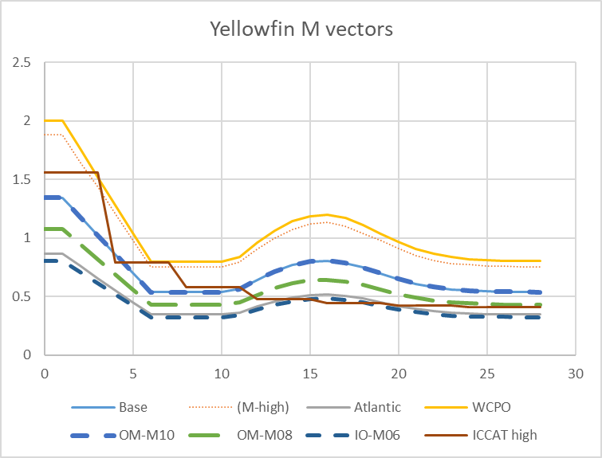
YFT OM recap
Changes to WPTT 2019 request
M – return to 2018 options
Drop high WCPO 1961 M
Replace low ICCAT M with Low IOTC M
Retain intermediate M (to reduce bimodality)
2018 options = broken lines

Slide 2
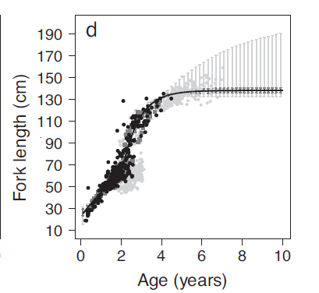
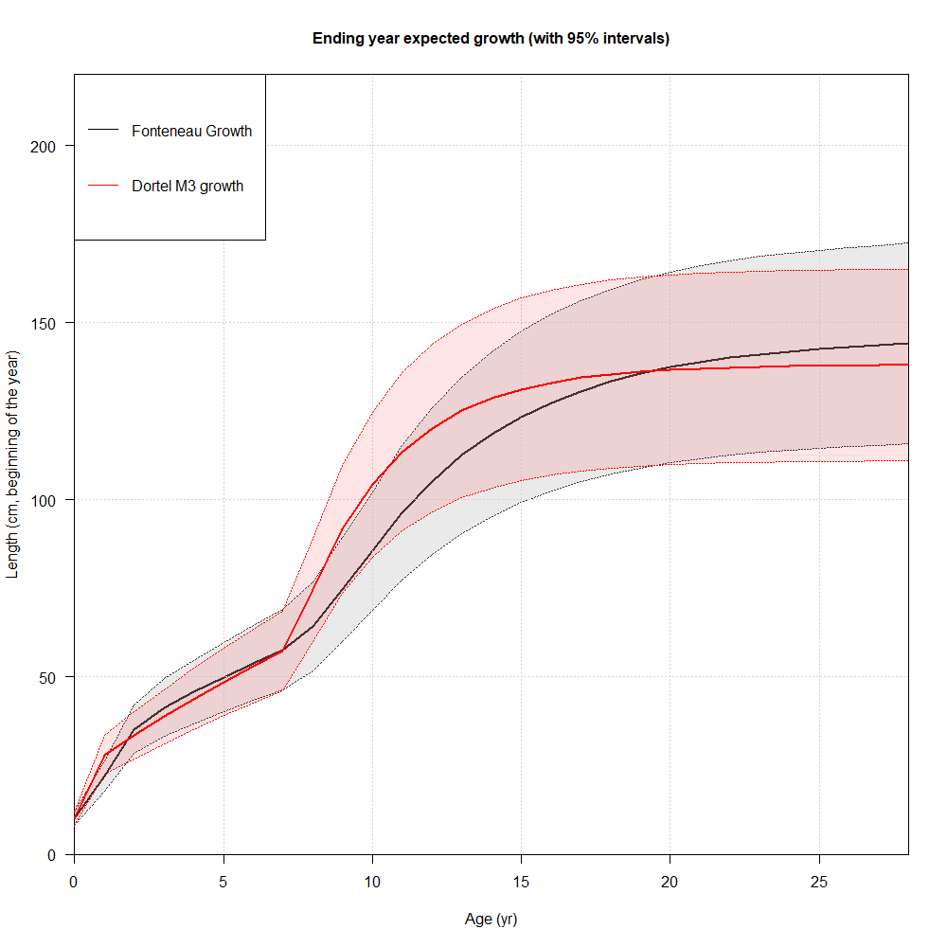
YFT OM recap
Changes to WPTT 2019 request
Growth:
Adopt Urtizberea et al 2020
Fonteneau
Dortel 3 lognormal
Ignore variance issue

Slide 3
YFT OM recap
Changes to WPTT 2019 grid
CPUE approach:
Retain 0, 1% catchability trends
Drop other ad hoc options
Request CPUE Working Group to add MSE uncertainty considerations to ToR (longer-term objective)

Slide 4
YFT OM recap
Changes to WPTT 2019 grid
What about PS FS CPUE?
Some MSE code changes required - depend on expected level of integration, i.e.:
OM conditioning only?
CPUE projection for integration in an MP?
But is PS FS CPUE plausible?

Slide 5
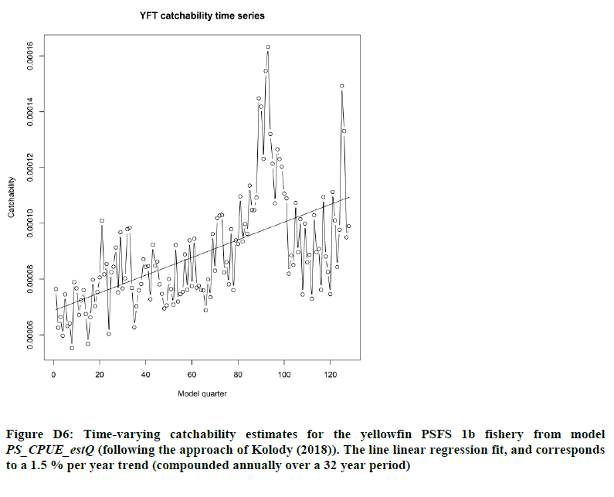
PSFS CPUE q Trend 1.5% per year
Fu et al 2018
IOTC–2018–WPTT20–33
Conflicts strongly with LL CPUE
Is the OM the place to address these issues, before TCMP?

Slide 6
LL CPUE catchability constant PSFS CPUE catchability +1.5% per year
Fu et al 2019
Are purse seiners adopting new technology and fishing more effectively?
PS q
LL q
Time

Slide 7
PSFS CPUE catchability constant LL CPUE catchability = -1.5 % per year
Fu et al 2019
Or are longliners becoming less effective over time?
PS q
LL q
Time

Slide 8
YFT OM recap
Changes to WPTT 2019 request
Spatial Structure:
4 Areas & 2 Areas
Implications:
Substantial MSE projection code modifications probably required
Does 2 Area structure actually add a new perspective?
How much is attributable to removing the tags?
How much attributable to east-west isolation?
How much attributable to different Q scaling assumptions?
Tag weight options
25% 1.0 (4 A)
25% 0.1 (4 A)
50% 0.0 (2 A)
Regional scaling factor and shared Q application needs rethink for 2 A

Slide 9
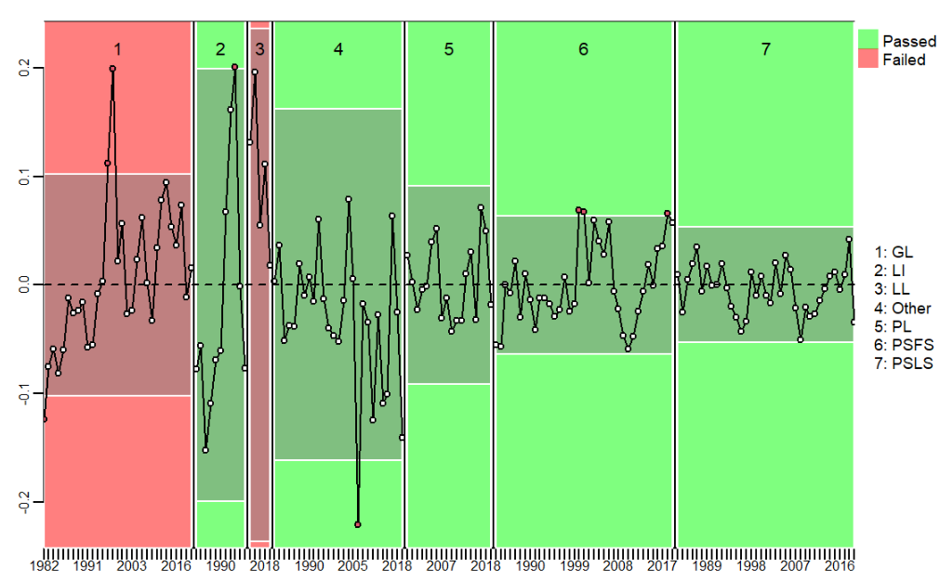
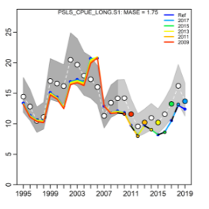
YFT OM recap
Changes to WPTT 2019 request
Brave New World of diagnostics
Still evolving – difference between assessment and OM context
Need Henning help to implement the new ones if required (note quarters as years SS configuration)

Slide 10
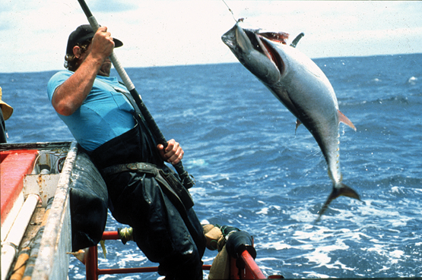
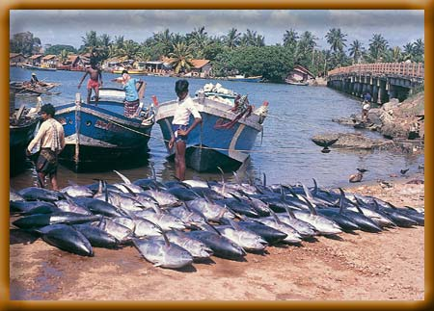
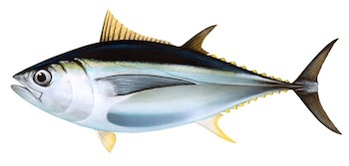
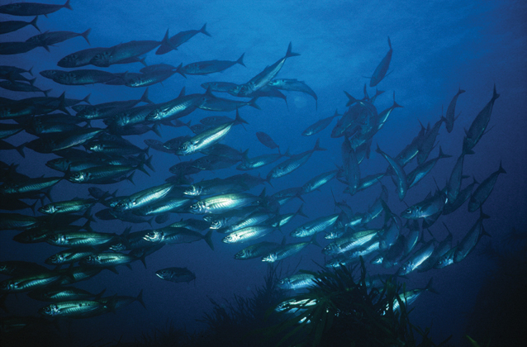
IOTC–2020–WPM11–11 IOTC Bigeye Management Strategy Evaluation: October 2020 Update & IOTC–2020–WPM11–13 A joint Process and Observation Error Random Effects Management Procedure Dale Kolody Paavo Jumppanen Jemery Day CSIRO Oceans & Atmosphere, Australia

Slide 11
Outline
Software and documentation available from:
https://github.com/pjumppanen/niMSE-IO-BET-YFT/
Current status of reference set OM
No IOTC feedback since WPTT/WPM 2019
A new MP based on a Joint Process and Observation Error Random Effects Production Model
Candidate MP testing
Feedback requests & Proposed Workplan

Slide 12
BET 2020 Reference Set OM: Full reconditioning
Derived from Fu et al. (2019) Stock Synthesis assessment (Methot and Wetzel 2013)
4 Areas
Quarterly dynamics 1950-2015
15 fisheries
Age-structured
Spatial BH Recruitment
Key differences between assessment and OM conditioning assumptions:
Temperate CPUE series simplification (renormalized by season and merged)
OM initial N = Assessment final N + age-dependent error
Uncertainty expanded to 8 dimensions
SS Recruitment deviation constrained for 12 quarters

Slide 13
2. CPUE discontinuity resolved
(2019 slide)
MP must always use the same observed CPUE series.
OM 2 not consistent with CPUE 2
Current approach calculates q based on whole time series means
CPUE 1 (MP uses this series)
Vulnerable Biomass 2 (fits CPUE 2)
Relative abundance
Two changes to MSE code:
CPUE projection error characteristics tied to individual SS models in OM
Rare recruitment anomalies fixed by constraining recent recruitment for 12 quarters
Time

Slide 14
BET 2020 Reference Set Operating Model
WPTT 2020
7 Dimensions
Fractional factorial design of 72 models
Alternate CPUE series not produced in 2019
Proposed CPUE group ToR to be expanded to explicitly include MSE uncertainty needs

Slide 15
Model plausibility evaluation
Same approach and issues as per yellowfin

Slide 16
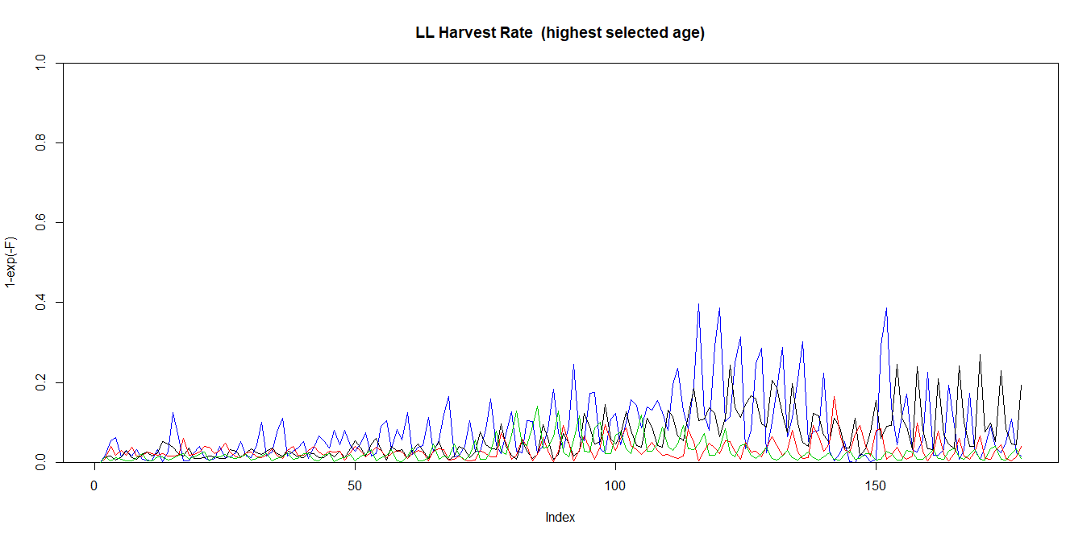
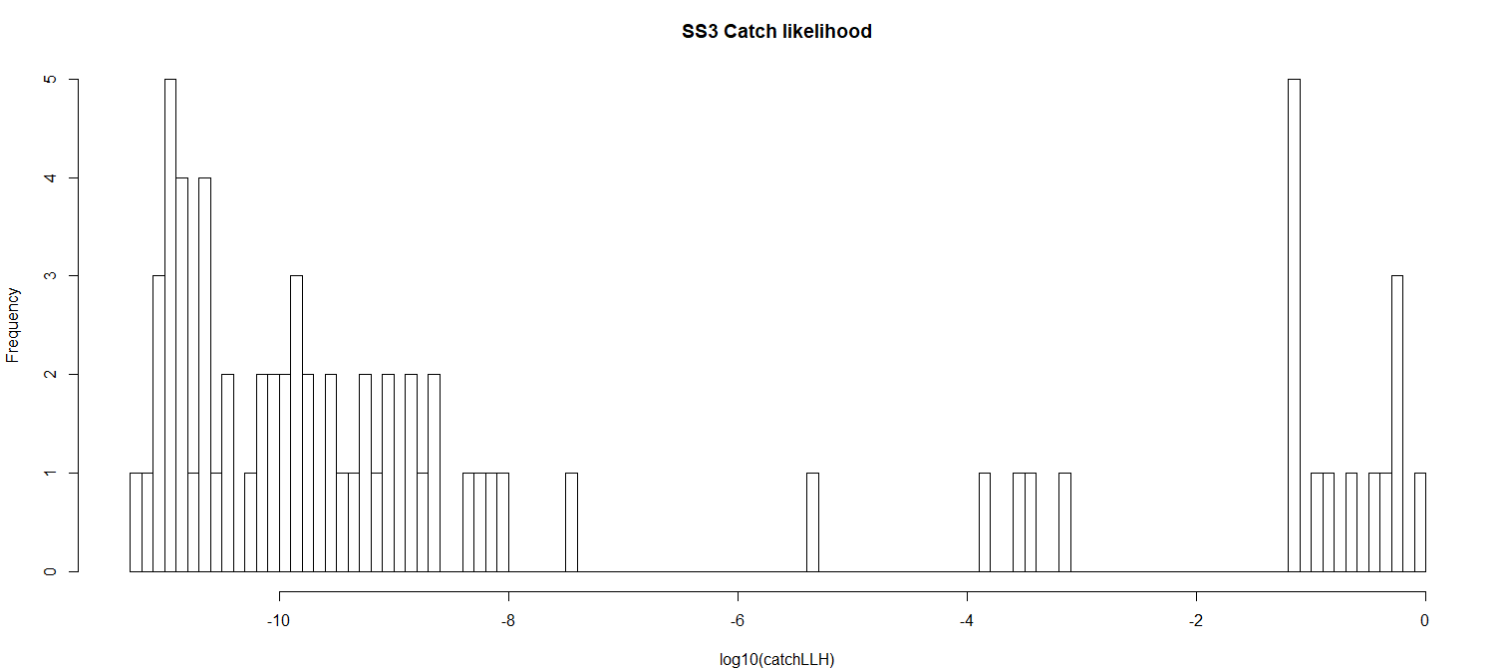
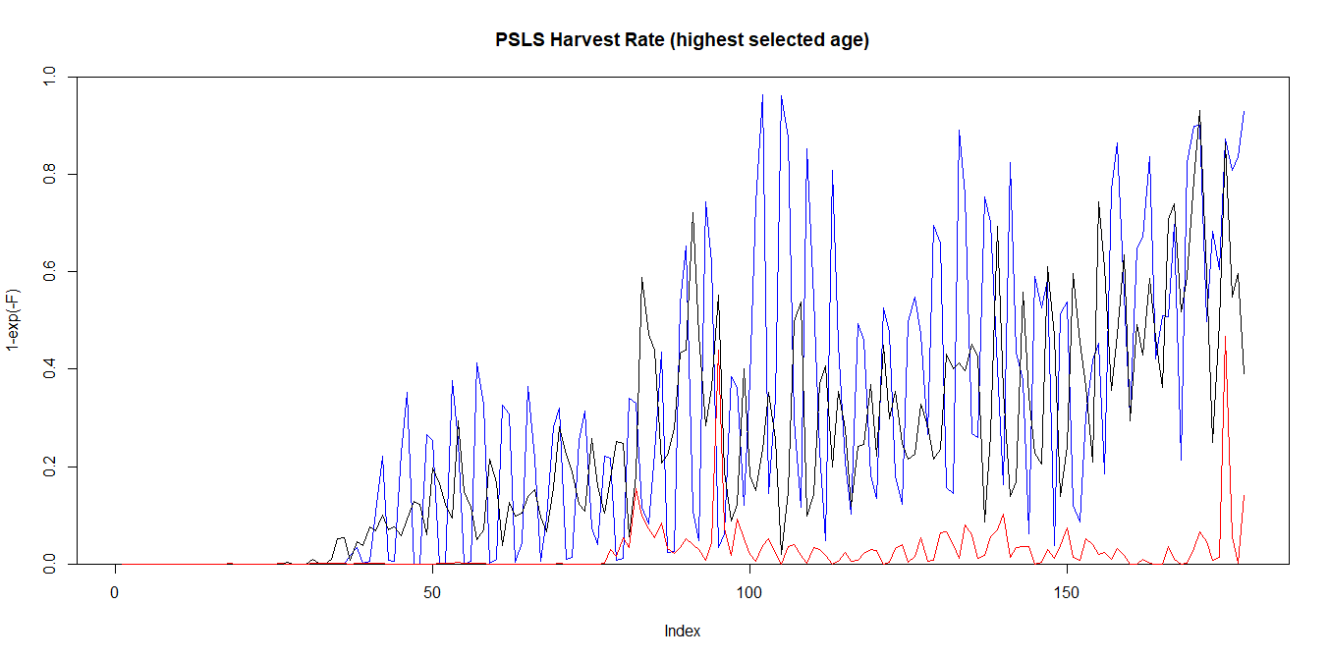
Harvest Rates (Highest selected age)
OM Catch Likelihood distribution
Longline max H ~ 0.4
Purse Seine LS max H = 0.99+

Slide 17
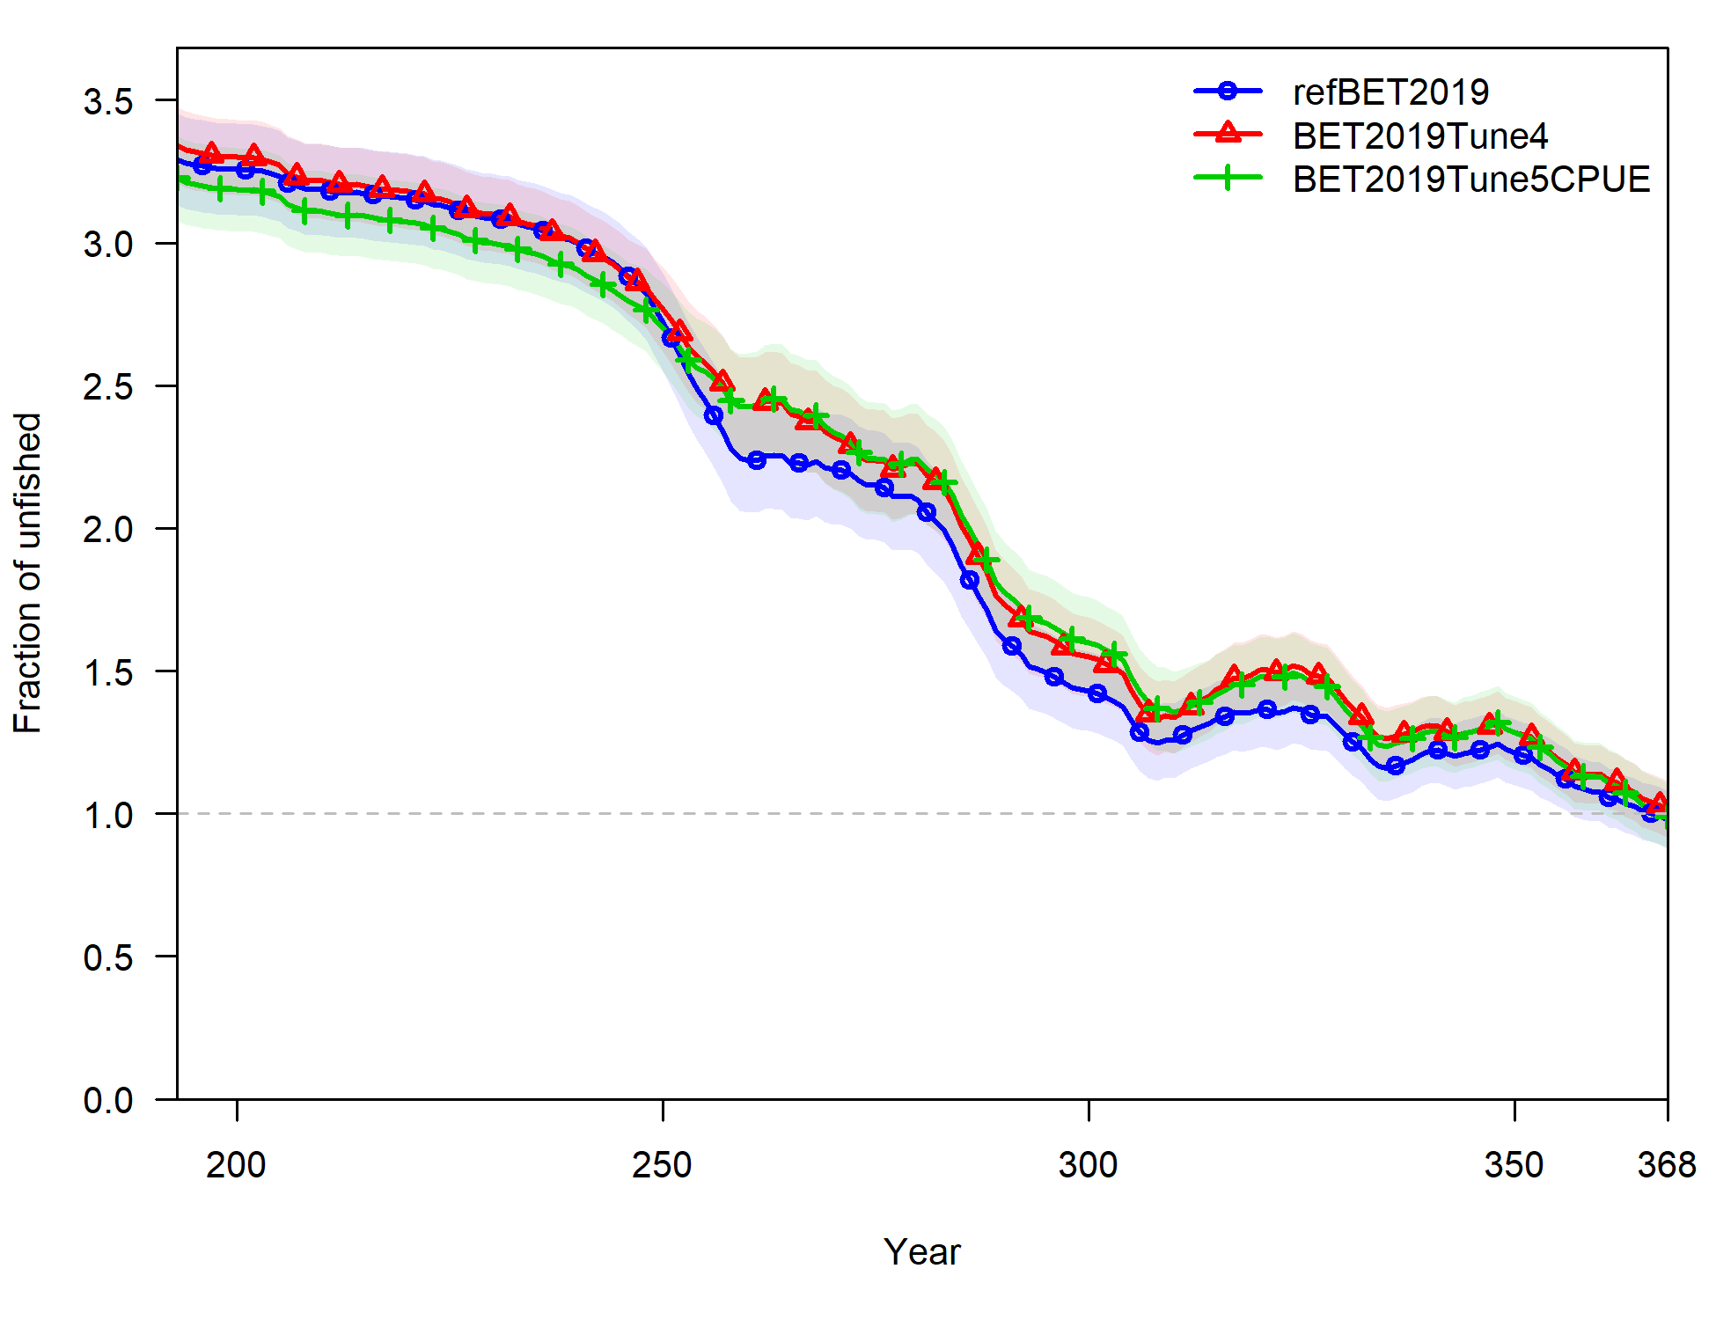
Iterative Reweighting (5 iterations)
Pacific Fishery Management Council (2018) procedure
Tags not re-weighted
Net effect small relative to uncertainty in OM grid

Slide 18
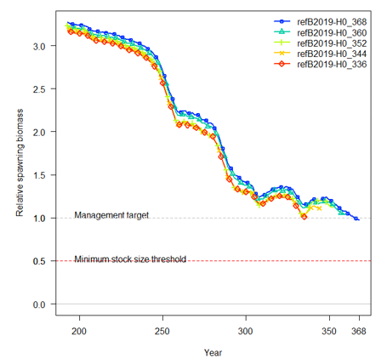
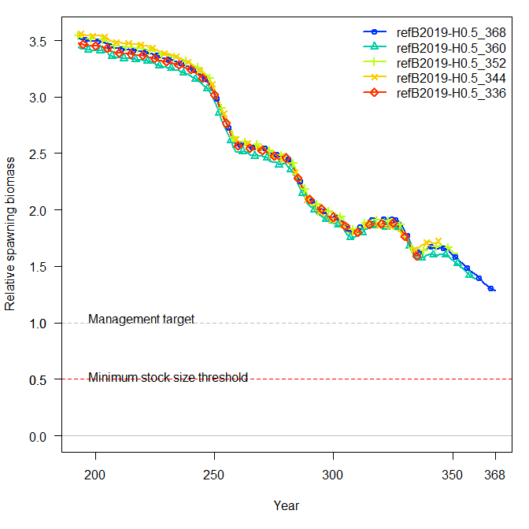
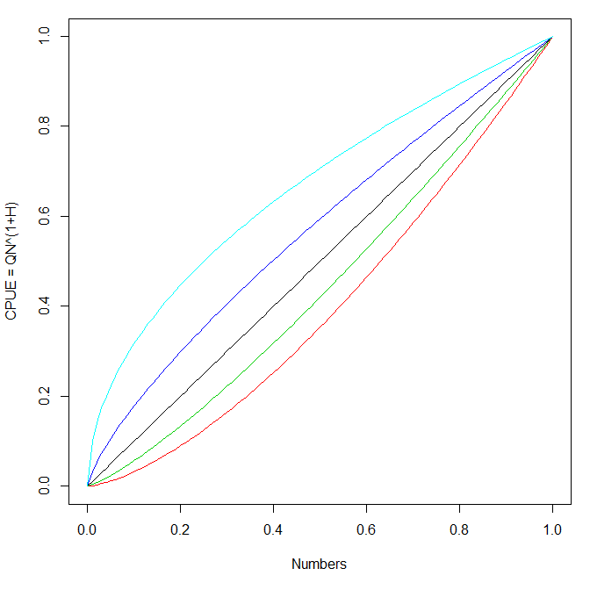
Hyperdepletion Parameter (H) and Retrospectives?
H = 0.5
H = 0 (default)
Non-linear relationship between abundance and CPUE can introduce a retrospective pattern, but is not necessarily the solution

Slide 19
WPM 2020 requested Robustness scenarios
3% per year tested

Slide 20
Bigeye Management Procedure Evaluation

Slide 21
IOTC–2020–WPM11–13 A joint Process and Observation Error Random Effects Management Procedure (PTRE = Pella-Tomlinson Random Effects)
Old “hockey stick”
New PTRE Estimation Model

Slide 22

IOTC–2020–WPM11–13 Joint Process and Observation Error Random Effects Production Model for Management Procedures
Pella-Tomlinson production function:
Unchanged
New bit (productivity variability)

Slide 23
As tested to date:
Parameters:
k = carrying capacity (loosely bounded)
r = intrinsic population growth rate (see MSY below)
p = “shape” parameter (determines B(MSY)/k) (tight prior)
σ(I) = CPUE observation error variability (fixed = 0.15)
σ(P) = process error variability (loose prior)
MSY replaces r as the leading parameter for numerical efficiency (loose prior)
q = CPUE catchability (uses analytical solution)
Latent Variables:
ϵ(t) = annual productivity deviations (constrained by σ(P))

Slide 24
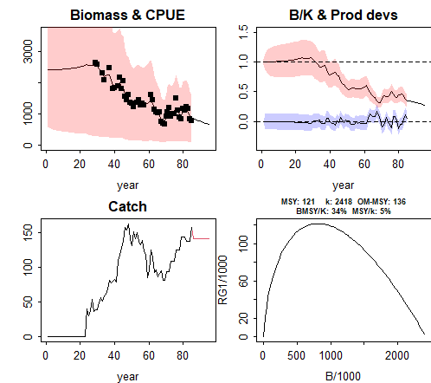
IOTC–2020–WPM11–13 Joint Process and Observation Error Random Effects Model for Management Procedures
Implemented with TMB (Template Model Builder)
Fast (~1 second per application vs: JABBA 2-3 minutes)
Generally reliable, but priors and penalties required for stability
Error estimates may be useful

Slide 25
PTRE-based MP with internal projection also under development
Solves for TAC required to get to a specific reference point by a specific date

Slide 26
BuildSys – a new R package for debugging TMB (and other) C/C++ DLLs
Developed by CSIRO - supports line by line step-through debugging of C/C++ DLLs, in association with the (free) Microsoft Visual Code development environment.
https://github.com/pjumppanen/BuildSys/releases/tag/1.0.4,

Slide 27
Bigeye Candidate MP Evaluation Results
TCMP (2019) tuning objectives:
B18.2: Pr(Kobe green zone 2030:2034) = 0.6
B18.3: Pr(Kobe green zone 2030:2034) = 0.7
i.e. The stock status is in the Kobe green quadrant over the period 2030-2034 exactly 60% (or 70%) of the time (averaged over all simulations).
15% TAC change constraint

Slide 28
BET OM Reference Set MP Evaluation Results (Tuning levels B2 and B3)
20 year performance summary is more pessimistic
Not alarmingly different from last year
2019 Results
2020 Results

Slide 29
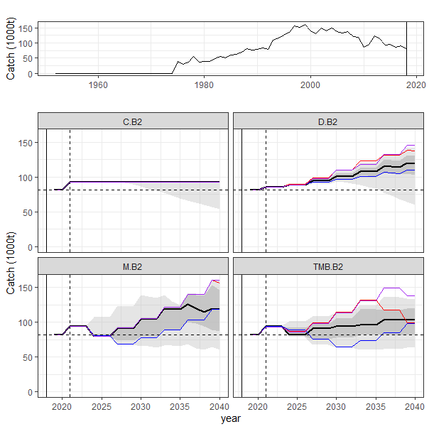
Key BET OM Reference Set MP Evaluation Results (Tuning level B2)
Median Catches higher than current
C. = Constant Catch
D. = CPUE-based
M. = old observation error only PT model
TMB. = new PTRE model

Slide 30
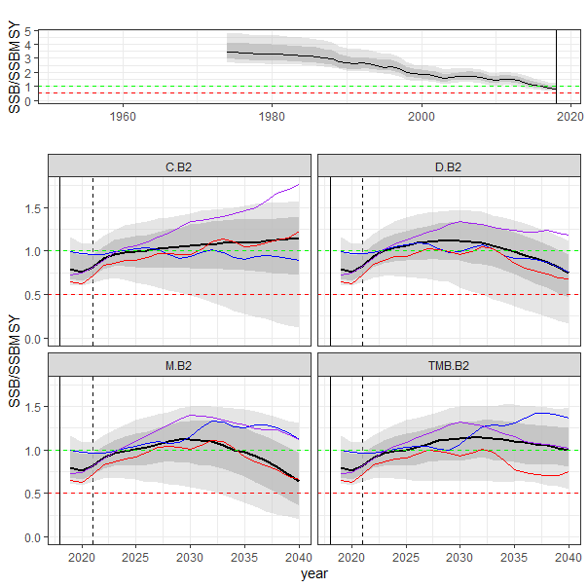
BET MP Evaluation Results
Spawning Biomass
Joint Process/Observation Error model learns faster and manage risk better
Other MPs are more adversely impacted by TAC change constraint
TMB MP

Slide 31
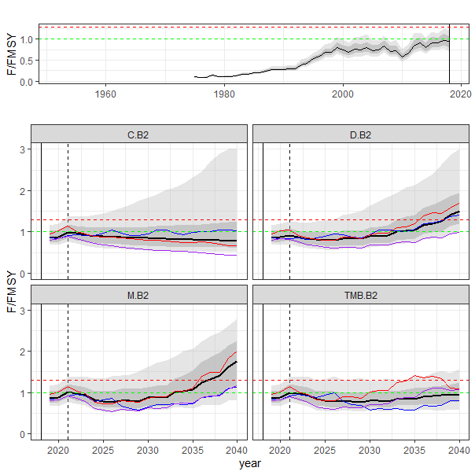
BET MP Evaluation Results
Spawning Biomass
Fishing Mortality
TMB MP
TMB MP

Slide 32
Robustness test results
See WP
Tend to have a predictable adverse effect, but not alarming

Slide 33
Conclusions
Reference Set OM updated as requested by WPTT/WPM 2020
CPUE discontinuity resolved (mostly artefact of recruitment)
Alternate CPUE standardization was not available –
requires CPUE Working Group input
Very high F in some (PSLS) strata
Some retrospective issues
Did not find a solution – not sure they are important
Reference Set MP evaluations more pessimistic than 2019
Tuning level B.2 (60% green Kobe) still likely to recommend catch increases
No obvious need for alternative MP tuning objectives
New MP based on Pella-Tomlinson Random Effects model appears to “learn” faster and reduce overfishing risk
MP development project funding expires June 2021

Slide 34
WPM / WPTT Feedback:
Proposed Workplan for 2020 TCMP:
Maintain current Reference Set OM?
Is F > 2.9 for some strata acceptable? (H > 95%)
Is F > 6.0 for some strata acceptable? (H > 99.5%)
Utility of “new” assessment diagnostics?
Maintain current Robustness Tests?
Continue development of TMB-based MP
Internal projections
Incorporate MP model uncertainty
Longer term concerns:
Alternative CPUE series from CPUE working group?
Catch reporting issues related to recent fishery changes?

Slide 35
Merci Thanks!
With thanks to the Australian Department of Foreign Affairs and Trade and FAO/IOTC for funding support, and the WPTT, WPM, TCMP and MSE Task Force for constructive engagement, and the legacy of countless clever modellers, statisticians, computer scientists and biologists upon which everything is built.

Slide 36
Extra Details…if required

Slide 37
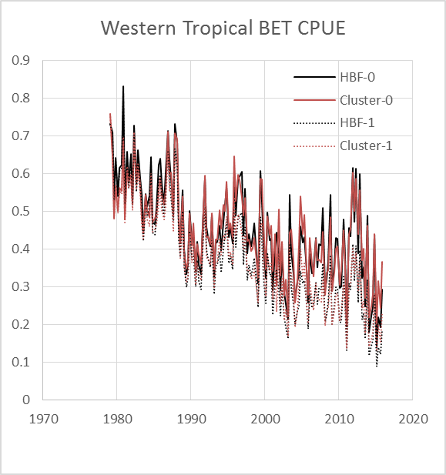
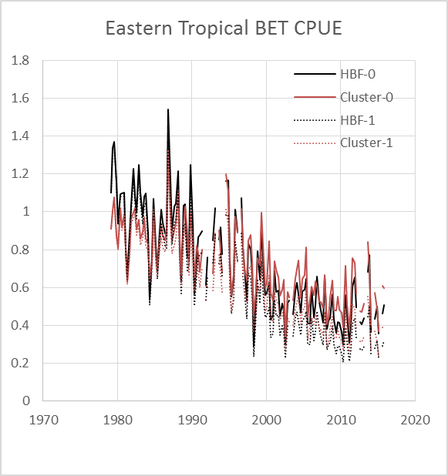
8 sets of Tropical CPUE series – 2 X Standardization targeting options 2 X q trend options (2 X area weighting factors not shown)
(2019 slide)
Alternate CPUE series had a smaller effect than the 1% per year q trend

Slide 38
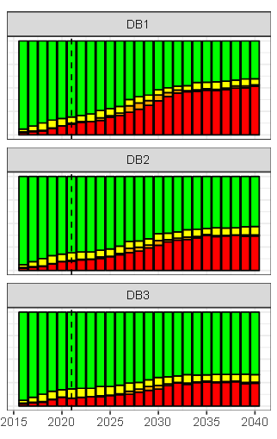
Visualizing the Tuning Objectives: Time series of Kobe quadrant probabilities
B1: 50% Kobe green zone
B2: 60% Kobe green zone
B3: 70% Kobe green zone
38

Slide 39
Biomass outcomes for Reference and Robustness tests for tuning levels B2 and B3 (pre-PTRE)

Slide 40
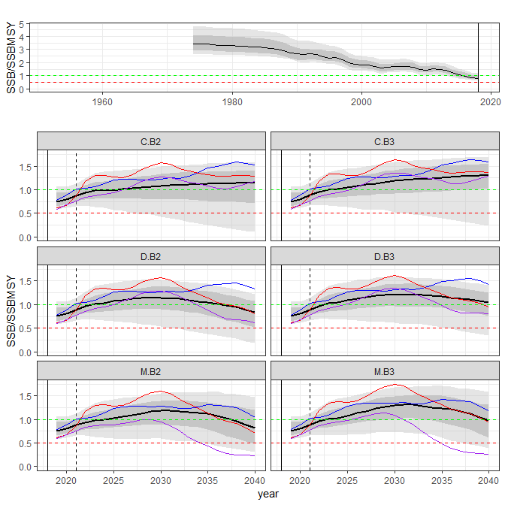
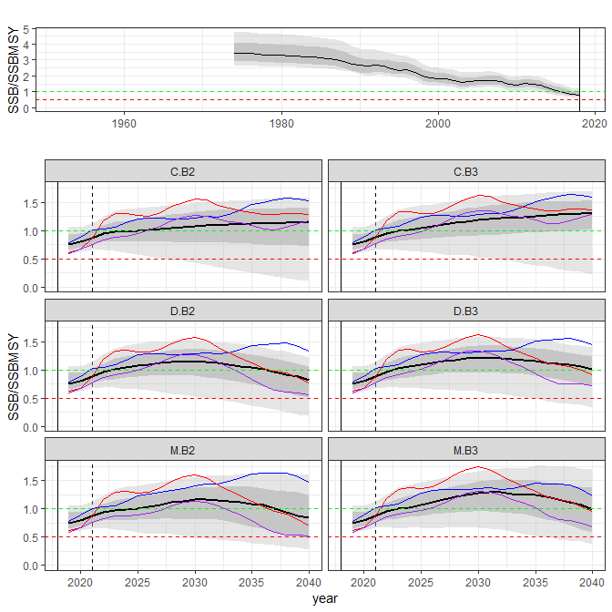
Biomass Time Series, 3MPs X 2 Tuning levels
Reference Set OM
CPUE CV = 30%

Slide 41
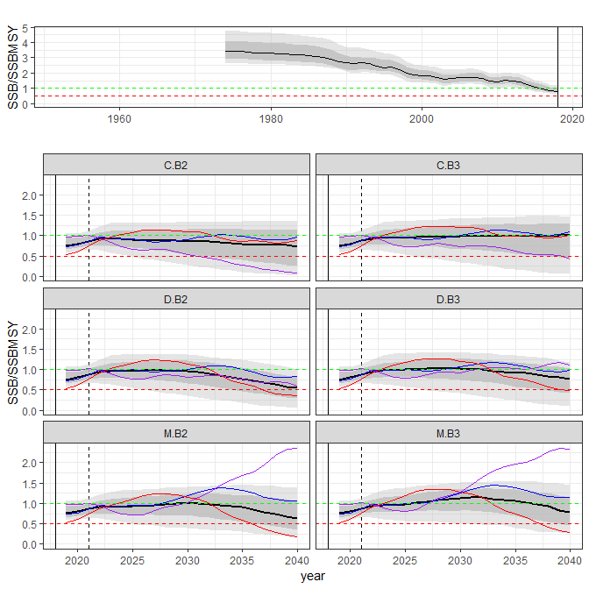
Biomass Time Series, 3MPs X 2 Tuning levels
Reference Set OM
10% Reported Overcatch

Slide 42
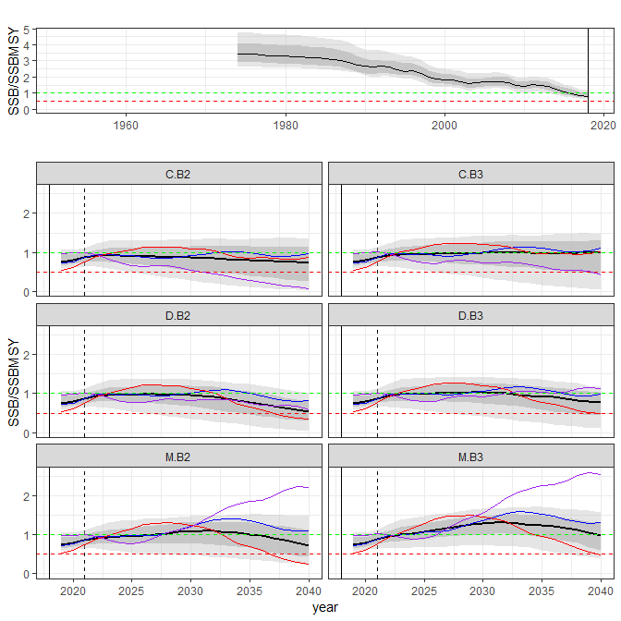
Biomass Time Series, 3MPs X 2 Tuning levels
Reference Set OM
10% Unreported Overcatch

Slide 43
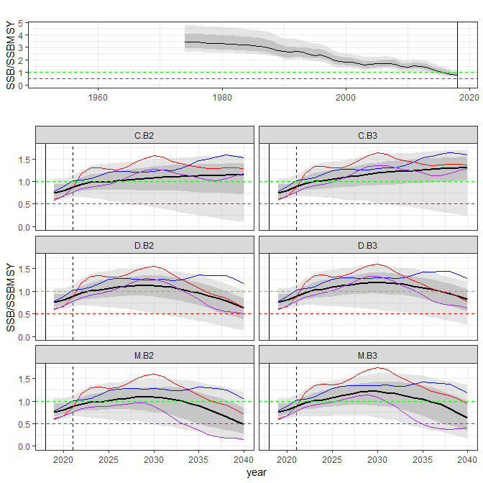
Biomass Time Series, 3MPs X 2 Tuning levels
Reference Set OM
3% per year Catchability increase in projection period

Slide 44
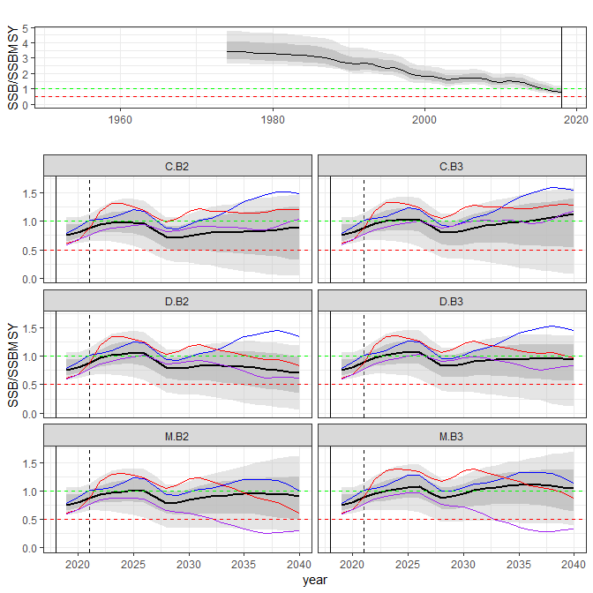
Biomass Time Series, 3MPs X 2 Tuning levels
Reference Set OM
Recruitment shock
(55% of expected 8 qtrs)

